Slide 2
Outline:
The problem we need to solve and overview of the data
Supervised learning both regression and classification approach
EDA
Regression
Classification
Result
Github link: https://github.com/carsonxie/Machine-Learning-Projects/tree/main/c1%20Supervised%20Learning%20method

Slide 3
What problem are we trying to solve?
Goal: For classification predict sale record is organic or not
For regression, predict average sales price
organic
Predict
Avocado sales data.
(18,249, 14)
traditional

Slide 4
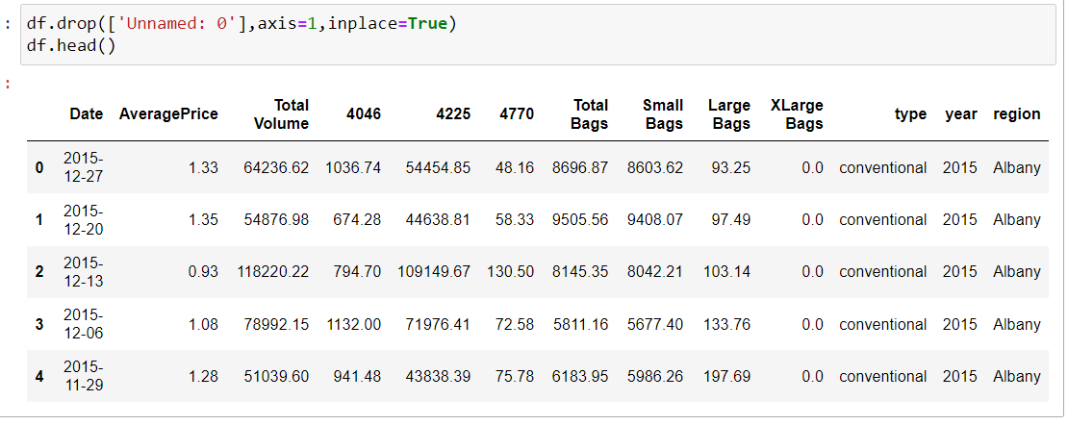
Overview of the data
Original train dataset: shape (250,300)

Slide 5
Supervised method
Question to ask and try to solve:
What information did EDA tell us?
Which feature type is suitable for classification problem?
What about regression?
Notes:
Kmean and hierarchy clustering

Slide 6
Code go through
https://github.com/carsonxie/Machine-Learning-Projects/blob/main/c1%20Supervised%20Learning%20method/project%201%20report.ipynb

Slide 7
Result
Classification : random forest model achieve 0.99 f1 score, logistic regression has 0.93 f1
Regression: when there are outliers ， mean absolute error is more stable. random forest regressor mas=0.14, linear regression with lasso is 0.31
Feature importance: total volume, large bags…

Slide 8
Thank you for watching !

Slide 9
Reference and further reading:
https://www.youtube.com/watch?v=7kLi8u2dJz0&ab_channel=codebasics
https://www.youtube.com/watch?v=-9vVhYEXeyQ&ab_channel=Peltarion
Notebook link:

